Slide 1

Communicating Data Visually: Display Templates
ComSciCon
March 2019

Slide 2
How to use these templates.
The following templates have been provided to enable you to develop graphs, charts, tables, and other visual displays.
As you consider which display to use, think about:
Your audience: what will communicate your message effectively?
Your data: what is the story you want to communicate?
Precision: how precise does the visual form need to be? Lines and bars are very precise, while bubbles, pies, and the saturation of hues are less precise.
Product: where will the display be used? Sometimes when choosing between display, selecting one to add visual interest and diversity is a driver in the decision process.
All templates have editable data embedded in the PowerPoint deck, and can be used as a starting point – adapt to your own needs!
Notes:
Adapted from the EvalFest Graph, Table, Chart, and Display Templates (September 2018), supported by the National Science Foundation, UNC Morehead Planetarium and Science Center, Science & Health Education Partnership, and Karen Peterman Consulting, with design expertise from Excella Consulting.

Slide 3


I need to represent a percent of a total for a single measure.
81%
of returning attendees extended their experience by looking for more information or doing another activity related to a Festival topic
81%
Clockwise, from top left: big number, 100% stacked bar, bar chart, icon matrix, donut chart, waffle chart

Slide 4
81%
Notes:
Sometimes all you need is a number!

Slide 5
81%
Notes:
Inverting the colors can increase readability and variation.

Slide 6
81%
of returning attendees extended their experience by looking for more information or doing another activity related to a Festival topic
Notes:
You may want to add minimal text or graphics, especially if this is a report and not a presentation.

Slide 7
Extended their experience
% of total attendees
Notes:
An 100% stacked bar is a graphical way of displaying just a single value.

Slide 8
Notes:
A bar chart can also be used to show the difference between ‘yes’ and ‘no’.

Slide 9
Notes:
An icon array is a graphical way of displaying just a single value. In some instances, where precision (e.g. “81%”) is less important that helping your audience understand the data, icon arrays represent a rough approximation. Here, “Four in five participants…” is shown instead of 81 out of 100 people to represent the 81% statistic.
To edit this array, select an icon and change the Graphics Fill or Graphics Outline on the Format ribbon.

Slide 10
Notes:
A donut chart showing a single category (81% of the total) can be an effective simple display, and is sometimes selected to add visual interest to a report or presentation. Donuts should NOT be used side by side to make additional comparisons (use stacked bars instead – see slide XX) and are not effective for values that could exceed 100% (use a bullet chart or overlapping bars instead).

Slide 11
Notes:
While pie charts are not a favorite of many people, they can be useful when comparing 2 groups.
Best practices when using a pie or donut to be mindful of:
Order segments from largest to smallest starting at twelve o’clock and working clockwise
Direct label the segments to minimize confusion on what category each segment represents
Ensure all segments sum to 100% of the total
Limit to 2-3 segments for readability; generally accepted best practice is no greater than 5 segments.

Slide 12
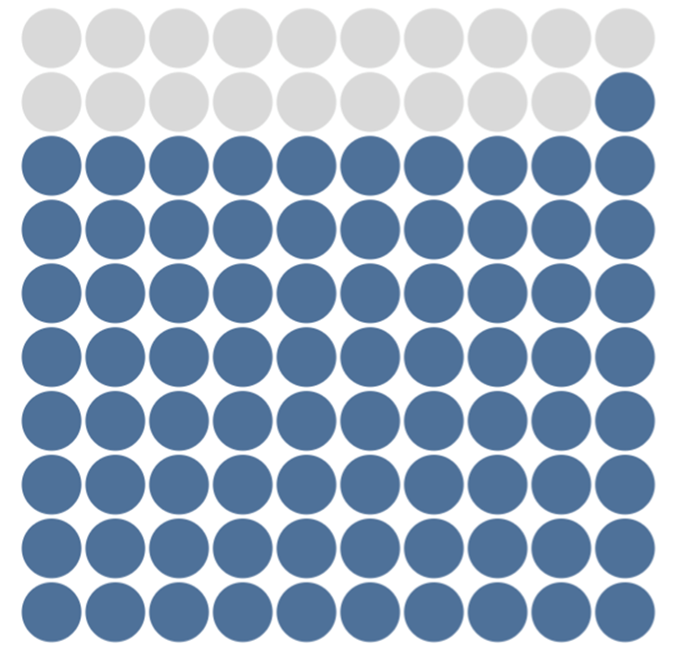
81%
81%
You may be familiar with a icon array of circles used for a similar purpose as these waffle charts. In this template deck, waffle charts are presented as an easier-to-read alternative. See notes for additional details on why.
Notes:
Waffle charts provide a simple display for a single value or part to whole.
This slide includes two ways to create waffle charts in powerpoint, both of which require some manual formatting effort. The left is a simple 10x10 table with the cells color coded to represent 81%. The right is a stacked column chart with 10 columns, 10 series, and an overlap width of zero. It also requires custom color coding the different series.
Why the recommendation to use waffle charts instead of the icon array of circles?
Both emphasize a part-to-whole comparison, and aim to achieve a similar goal.
Squares have less white space (where the eye can rest) than the dots, creating a better visual comparison of the blue and gray segments.
Waffle charts are most effective at displaying the comparison of a single category to a whole. If using multiple categories or colors, consider an alternate chart type like a bar chart or dot plot.

Slide 13
81%
Notes:
Removing the gridlines that define the individual segments of a waffle chart transforms the chart into a treemap. This chart type emphasizes the total space taken up by a given category rather than the precise number of units.

Slide 14
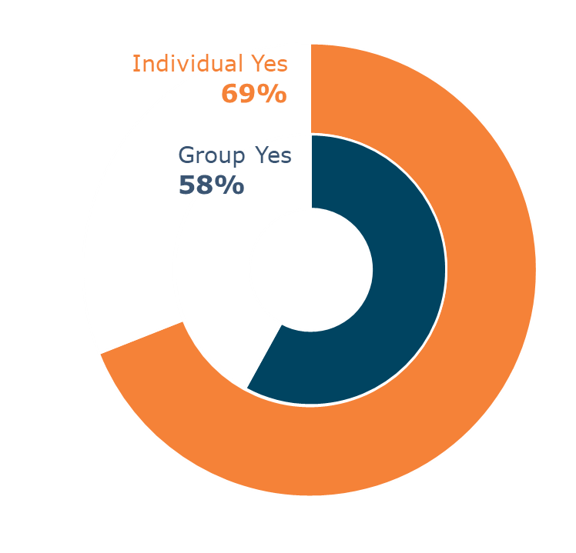
I need to compare results from multiple measures.
Learned something new
Follow up activity
Posted on social media
81%
64%
22%
Clockwise, from top left: 100% stacked bar, bar chart, laylollipop chart, clustered waffle chart

Slide 15
Notes:
Bar charts are very versatile and present a precise comparison across categories or measures on the same scale. Four different ways to format the same bar is displayed here.
If there is no preset order (e.g., chronological, Likert scale, etc.), it is best to order the categories from most to least or least to most.

Slide 16
Notes:
You may want to decrease the intensity of the color as you decrease in frequency. You can alter this with the color transparency.

Slide 17
Notes:
Column charts are an alternative to bars, and are often used to display distributions of demographic data (sometimes without any gaps, creating a histogram).
When waffling between a column (vertical) and bar (horizontal) chart, consider the length of your category names. Bar charts accommodate longer category labels without compromising readability, while columns are better fit for short category names.
This chart provides an example where you would not want to alter the order, because the categories have a natural order to them.

Slide 18
Notes:
Lollipop charts are an alternative to bar charts. They are less visually precise, due to the rounded ends.

Slide 19
Notes:
Lollipop charts can also be displayed horizontally. Either include an axis or data labels to avoid visual clutter and redundancy in your display. Data labels provide more precision around the numbers, while the axis enables the user to focus primarily on comparison of the lengths of the different “lollipops”.

Slide 20
Notes:
A layered donut chart displays the comparison of 2 related values.
When editing, note that each donut is individually constructed and then layered together.
Similar to pie and donut chart considerations, use layered donut charts sparingly. Consider how precise your visual comparison of two slices needs to be, as the larger radius of the outside ring will always appear larger. The functional purpose is to compare the end points of each ring, not the total size emphasized with color.

Slide 21
Learned something new
Follow up activity
Posted on social media
81%
64%
22%
Learned something new
Follow up activity
Posted on social media
81%
64%
22%
Notes:
Unlike donut and pie charts, waffle charts can be arranged in rows, columns, or grids to show multiple values.
Waffle displays emphasize the individual values for each category first (with the large numbers, which could be omitted and moved to a title), and then the comparison between questions or categories. The emphasis on individual responses can be further emphasized with different colors.

Slide 22
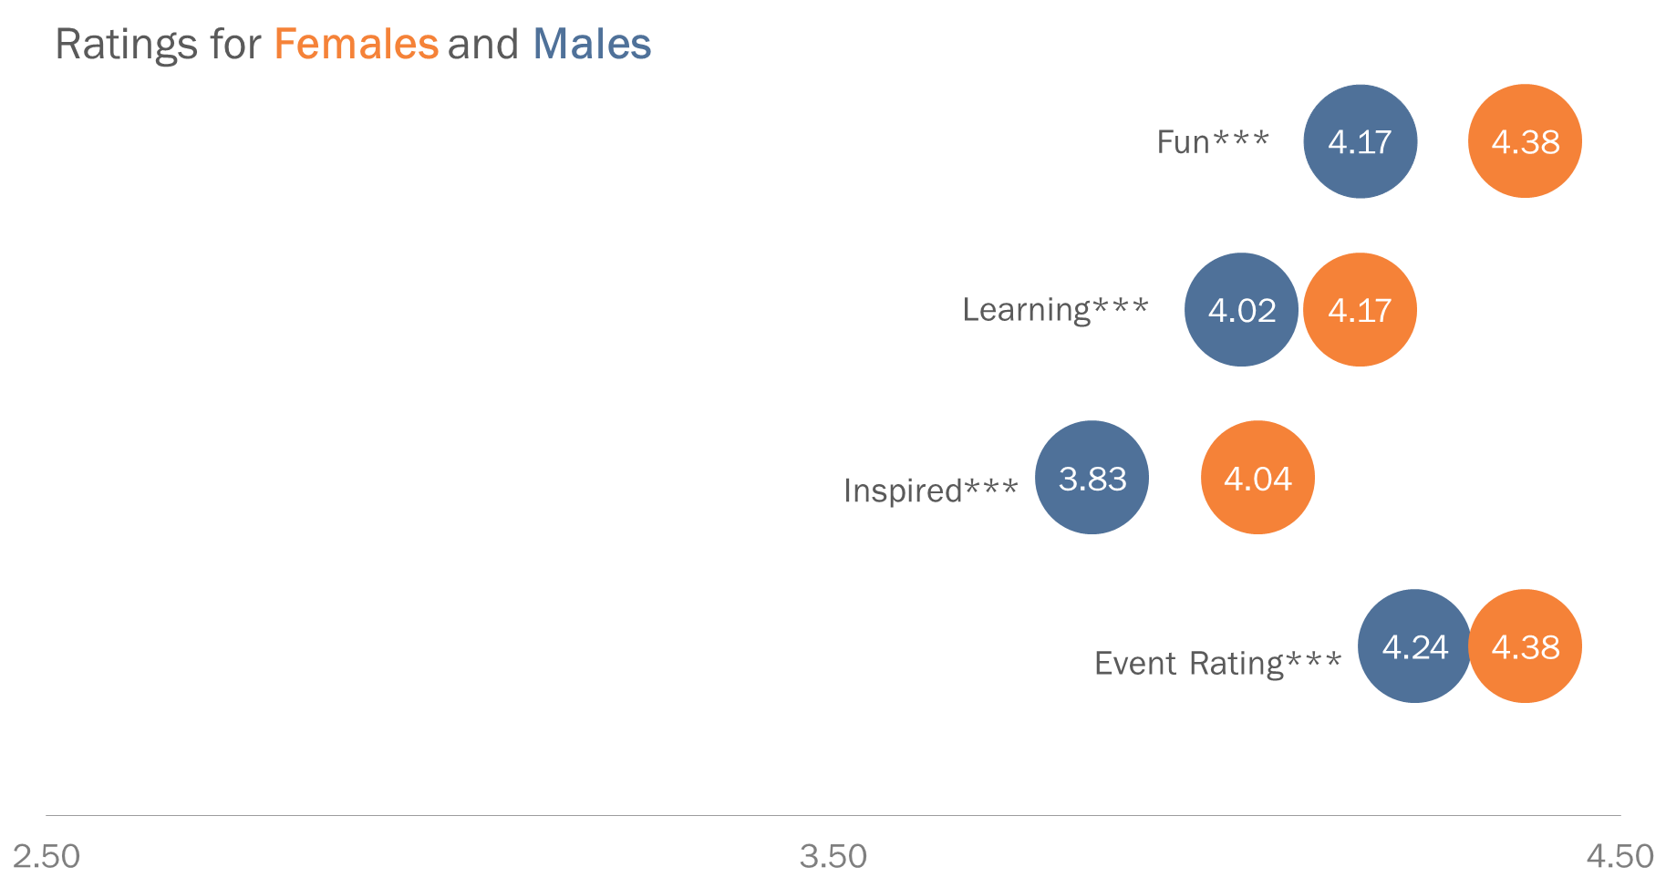
I need to compare groups across multiple measures or responses.
Ratings & Outcomes for Females and Males
HS AA BA/BS Post Grad
Clockwise, from top left: dot plot, dumbbell plot (remove bars for dot plot), paired bar chart, small multiples chart, 100% stacked bar chart

Slide 23
Ratings for Females and Males
Fun***
Notes:
A dot plot is a way to compare two groups. These are typically best to use when you have 2-3 groups.
Because the axis has been truncated, it can be left as an additional reference for the values. Alternately, delete the axis to focus on the values on the individual marks.

Slide 24
Notes:
Connected dot plots (also called “dumbbell charts”) emphasize the distance between two groups. These can be useful for two groups at two points in time or two separate groups.

Slide 25
Notes:
With data labels on the markers, the axis provides redundant information. If needed to emphasize the range, the horizontal axis can be kept, but here’s an alternate with a bit less visual clutter.

Slide 26
Ratings & Outcomes for Males and Females
Event Rating
Learning
Inspired
Awareness
Careers
Notes:
On dot plots, grid lines can be included for easy mapping of response categories to values, or deleted (left click to highlight on the template and delete).

Slide 27
Ratings & Outcomes for Males and Females
Event Rating
Learning
Inspired
Awareness
Careers
Notes:
If the precision of the exact values is not required, use a horizontal axis instead of data labels. Note that the axis is truncated (does not start at zero) in order to facilitate improved comparison between the two groups since the differences are small. In some cases, you may consider expanding the axis to a minimum value of zero.

Slide 28
Ratings & Outcomes for Males and Females
Notes:
A side-by-side bar graph can also be used to compare 2 groups within a number of categories. For groups where values are very close, the paired bar chart is less precise than the dot plot in highlighting the differences between the two groups, but is a familiar chat type for many audiences.

Slide 29
HS AA BA/BS Post Grad
Notes:
Stacked bar charts allow for comparison of a part to whole within a category, as well as comparison across categories.

Slide 30
HS AA BA/BS Post Grad
Notes:
Instead of an axis, use data labels for increased precision in the numbers and values across categories. This can be tricky for small segments though.

Slide 31
Notes:
Small multiples charts functionally “break” a stacked bar to better allow comparisons within a certain category (here, HS, AA, BA/BS, post-grad) as well as across. They can be read both down and across.
The trick to updating the small multiples template is to identify the “max” value (likely multiple of 5 or 10 that is above your max value in the chart), and then create white spacers by subtracting the values from the max reference cell (A8 in the sample data). Open the sample data to experiment. The vertical lines are equally spaced gridlines; for four categories, the gridlines are spaced at 0.25, but for five categories you would need to edit the spacing to 0.2, etc.

Slide 32
I need to display change over time.
Clockwise, from top left: line chart, area chart, slope graph, column chart, dumbbell plot, multi-series line chart

Slide 33
Notes:
Line graphs display trends clearly and effectively. Labeling one key point or adding an annotation/call out can add value for your audience.

Slide 34
Notes:
Area charts serve a similar function to lines.

Slide 35
Notes:
A column chart is often used for categorical data, but can also be used to display data over time. Emphasize a specific year (or other time point) by using gray for all columns except the value of interest which you can highlight with color.

Slide 36
Notes:
Slope graphs emphasize the magnitude and direction of change between two points.

Slide 37
Notes:
Repeated from previous section, since this chart type works well for change between two time points.
While a slope graph (previous slide) emphasizes the direction of change, a dumbbell plot emphasizes the size of the change between two points.

Slide 38
Notes:
Line charts can also include multiple series. Having a reference for comparison (average, quartiles, etc) can provide helpful context for interpreting your data.

Slide 39
I need to compare progress against a benchmark or comparison group.
Clockwise, from top left: overlapped bar chart, single category bullet chart, multi-year bullet chart

Slide 40
Notes:
An overlapping bar graph is helpful when making comparisons within each category, as well as across categories. Here, we compare the percentage of each race or ethnicity at the festival (orange) to the percentage within a particular region (e.g., within the US, a state, a city, etc.) (grey).

Slide 41
Notes:
Bullet charts provide two reference marks (often a target and long term goal) and a value achieved to date. Sometimes one of the target marks is displayed as a line or dot (not displayed here).

Slide 42
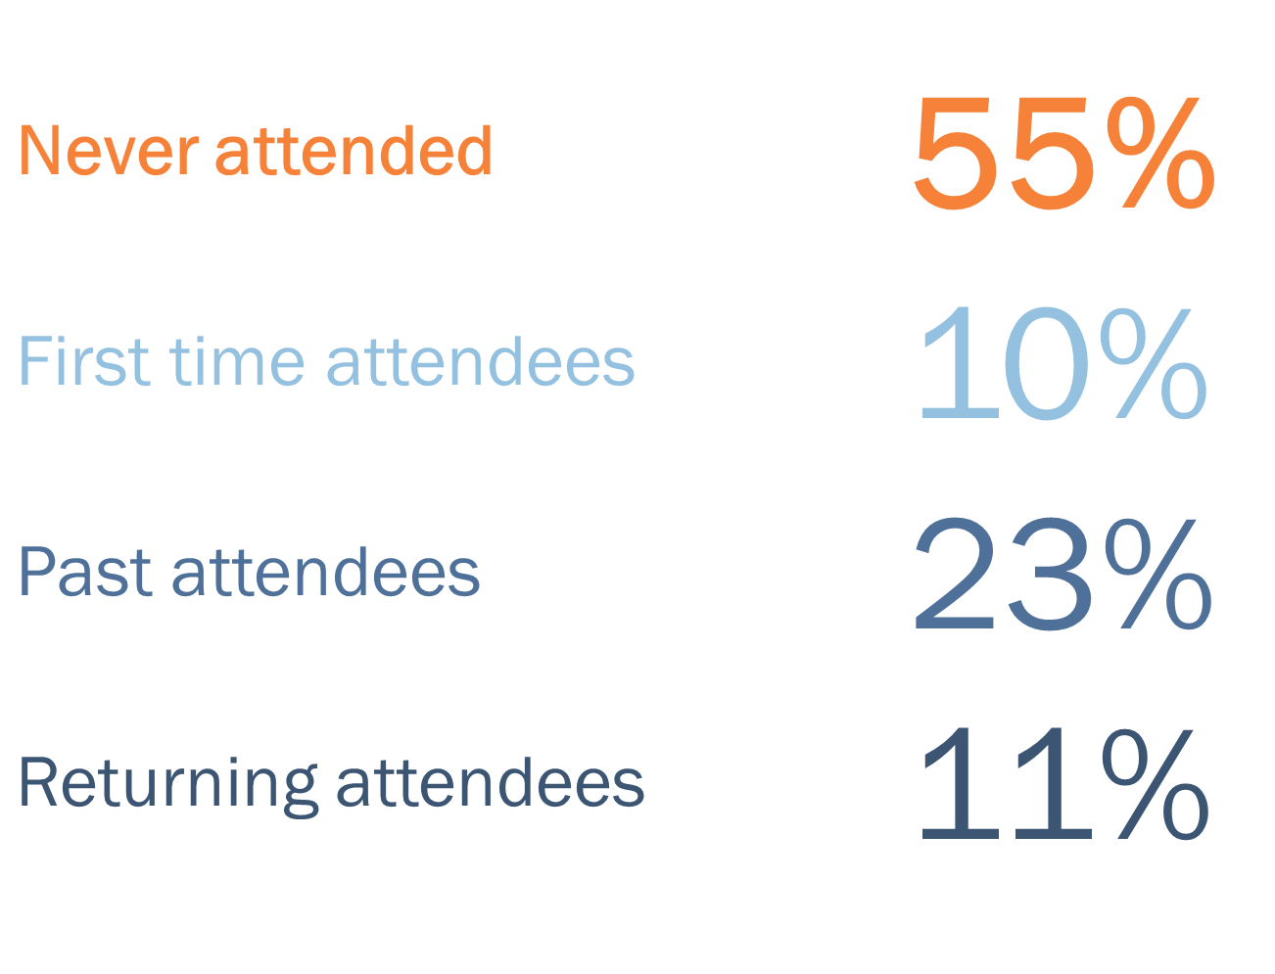
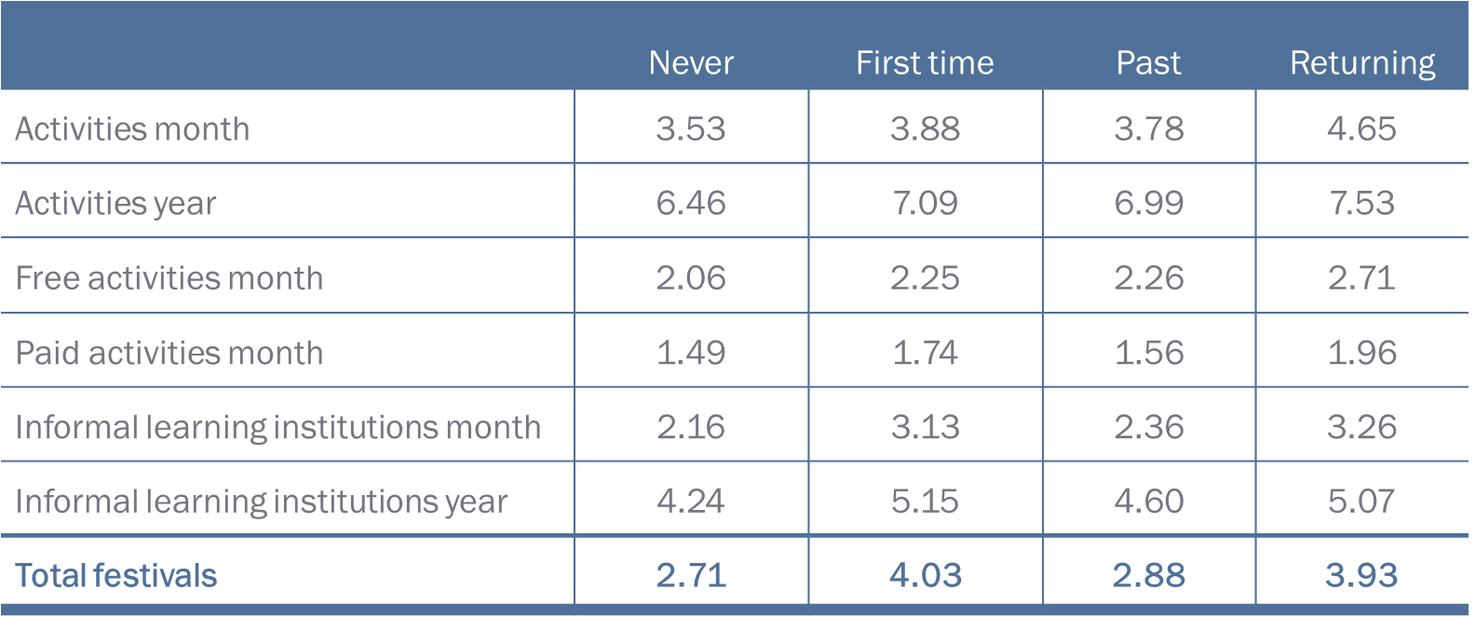
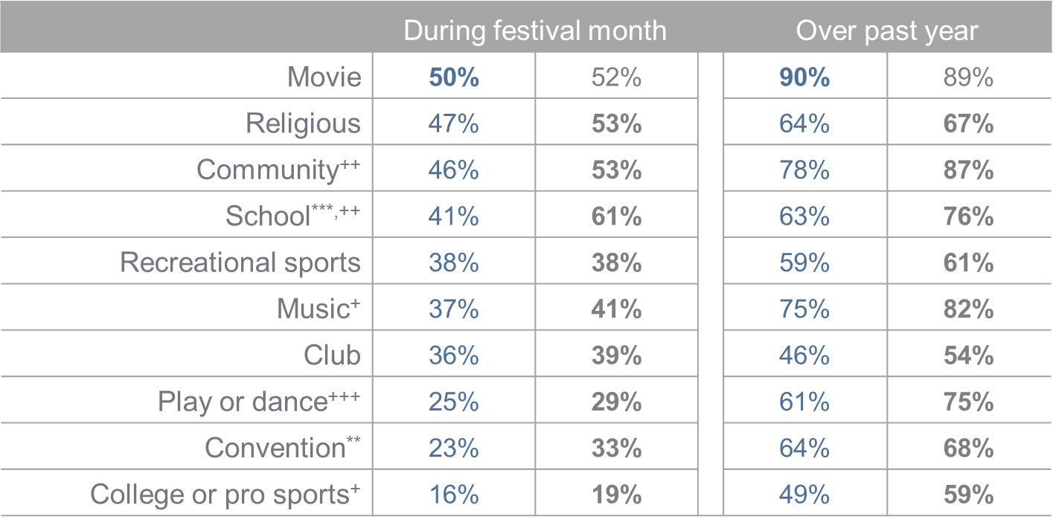
I need to present detailed information.

Slide 43
Never attended | 55%
First time attendees | 10%
Past attendees | 23%
Returning attendees | 11%
Notes:
Tables don’t have to be detailed and cluttered – they can also be formatted for simplicity as in this table of large numbers.
When using a display like this, consider if a bar chart would facilitate improved analysis (allowing for a quick visual comparison of the length of the bars) rather than displaying only the numbers. You can add data labels to the bars for the added precision of the values.

Slide 44
 | Never | First time | Past | Returning
Activities month | 3.53 | 3.88 | 3.78 | 4.65
Activities year | 6.46 | 7.09 | 6.99 | 7.53
Free activities month | 2.06 | 2.25 | 2.26 | 2.71
Paid activities month | 1.49 | 1.74 | 1.56 | 1.96
Informal learning institutions month | 2.16 | 3.13 | 2.36 | 3.26
Informal learning institutions year | 4.24 | 5.15 | 4.60 | 5.07
Total festivals | 2.71 | 4.03 | 2.88 | 3.93
Notes:
A basic table displaying ratings per group in several categories.
Left-oriented category text improves ease of reading down the column of categories (compared to center or right oriented text). A benchmark (“Total festivals”) is highlighted in bold, color text for reference (alternately, could be presented in gray to deemphasize

Slide 45
Other Events: Never attended, All other groups
I need to an easy to read data table comparing multiple metrics and periods.
 | During festival month |  | Over past year
Movie | 50% | 52% | 90% | 89%
Religious | 47% | 53% | 64% | 67%
Community⁺⁺ | 46% | 53% | 78% | 87%
School^{***,++} | 41% | 61% | 63% | 76%
Recreational sports | 38% | 38% | 59% | 61%
Music⁺ | 37% | 41% | 75% | 82%
Club | 36% | 39% | 46% | 54%
Play or dance⁺⁺⁺ | 25% | 29% | 61% | 75%
Convention** | 23% | 33% | 64% | 68%
College or pro sports⁺ | 16% | 19% | 49% | 59%
Superscripts indicate different levels of statistical significance
Notes:
A table comparing 2 groups in various categories and over 2 time periods. Use color to denote different groups; consider using a color to emphasize the group of interest and gray for the second group.

Slide 46
Other Events: Never attended, All other groups
 | During festival month |  |  | Over past year
Movie | 50% | 52% |  | 90% | 89%
Religious | 47% | 53% |  | 64% | 67%
Community⁺⁺ | 46% | 53% |  | 78% | 87%
School^{***,++} | 41% | 61% |  | 63% | 76%
Recreational sports | 38% | 38% |  | 59% | 61%
Music⁺ | 37% | 41% |  | 75% | 82%
Club | 36% | 39% |  | 46% | 54%
Play or dance⁺⁺⁺ | 25% | 29% |  | 61% | 75%
Convention** | 23% | 33% |  | 64% | 68%
College or pro sports⁺ | 16% | 19% |  | 49% | 59%
Superscripts indicate different levels of statistical significance
Notes:
A table comparing 2 groups in various categories and over 2 time periods. Use color to denote different groups.
This chart adds a spacer between the two time periods to emphasize that comparison should be between the pairs of values.

Slide 47
Resources
stephanieevergreen.com
Stephanie Evergreen is an internationally recognized expert in the area of data visualization. Her website and blog have several resources and demos that you may find helpful.
depictdatastudio.com/blog/
This is Ann K. Emery’s blog about data visualization. Like Stephanie, Ann is a renowned speaker and expert on data visualization.
public.tableau.com/en-us/s/
The Tableau Public website has lots of resources, how-to videos, sample data sets, etc. They also maintain a blog that focuses on data visualization.

